Slide 1
Chapter 7
Data Modeling Using the Entity-Relationship (ER) Model

Slide 2
Outline
Overview of the database design
An Example Database Application
Entity Types, Entity Sets, Attributes, and keys
Relationship

Slide 3
Database Design
Requirements collection and analysis
  Database designers interview prospective database users to understand and document data requirements
  Result: data requirements
  Functional requirements of the application

Slide 4
Database Design
Once all requirements have been collected and analyzed, the next step is to create a conceptual schema for the database. This step is call conceptual design.
Because these concepts do not include implementation details, they are usually easier to understand and can be used to communicate with users

Slide 5
Database Design
The next step in DB design is the actual implementation of the database, using a commercial DBMS
By using the DBMS, we can transform conceptual design from high-level data model into the implementation data model
This step is called logical Design or Data Model mapping
    Result is a database schema in implementation data model of DBMS

Slide 6
Database Design
Physical design phase
  Internal storage structures, file organizations, indexes, access paths, and physical design parameters for the database files specified

Slide 7
Overview of Database Design Process

Slide 8
Outline
Overview of the database design
An Example Database Application
Entity Types, Entity Sets, Attributes, and keys
Relationship

Slide 9
COMPANY example
The COMPANY database keeps track of company’s employees, departments, and projects
Suppose that after the requirements collection and analysis phase, the database designers provide the following description:

Slide 10
Example COMPANY Database
We need to create a database schema design based on the following (simplified) requirements of the COMPANY Database:
  The company is organized into DEPARTMENTs. Each department has a name, number and an employee who manages the department. We keep track of the start date of the department manager. A department may have several locations.
  Each department controls a number of PROJECTs. Each project has a unique name, unique number and is located at a single location.

Slide 11
Example COMPANY Database (Contd.)
  We store each EMPLOYEE’s name social security number, address, salary, sex, and birthdate.
    Each employee works for one department but may work on several projects.
    We keep track of the number of hours per week that an employee currently works on each project.
    We also keep track of the direct supervisor of each employee.
  Each employee may have a number of DEPENDENTs.
    For each dependent, we keep track of their name, sex, birthdate, and relationship to the employee.

Slide 12
ER DIAGRAM

Slide 13
Outline
Overview of the database design
An Example Database Application
Entity Types, Entity Sets, Attributes, and keys
Relationship

Slide 14

Example of a Relation
ER model describes data as entities, relationships, and attributes

Slide 15
Entities and Attributes
The most basic object that the ER model represents is an entity
Entity: thing in real world with independent existence
An entity maybe an object with a physical existence (a person, a car, house…) or it maybe an object with conceptual existence (a company, a job, or a course)
Each entity has Attributes --- the particular properties that describe it

Slide 16
Attributes
Attributes --- the particular properties that describe entity
Several types of attributes occur in the ER model
  Simple vs. Composite
  Single value vs. Multi-value
  Stored vs. Derived
  NULL Values
  Complex Attribute

Slide 17
Composite vs. Simple Attributes
Composite attributes can be divided into smaller subparts.
  For example: Address attribute of the EMPLOYEE entity can be further subdivided into street_address, city, state, zipcode. Street address can be subdivided into Number, street, and apt#
Simple attributes can not be further divisible
  For example, age, sex, wage
The value of a composite attribute is the concatenation of the values of its constituent simple attributes

Slide 18

Example of a composite attribute

Slide 19
Single value vs. Multi-value
Most attributes have a single value for a particular entity; such attribute are called single-valued
In some cases an attribute can have a set of value for the same entity --- for example, colors attribute for a car, or a college_degree for a person, such attributes are called multivalued
A multivalued attribute may have lower and upper bonds to constrain the number of values allowed for each entity

Slide 20
Stored vs. Derived
In some cases, two (or more) attribute claues are related --- for example, the Age and Birth_date of a person
The Age attribute is called a derived attribute and is said to be derived from the Birth_date attribute, which is called a stored value

Slide 21
NULL Values
In some cases, a particular entity may not have an applicable value for an attribute
  For example, apt#, college degree,
NULL can also be used if we do not know the value of an attribute for a particular entity---home phone
The meaning of the former type of NULL is not applicable, whereas the meaning of the later is unknown

Slide 22
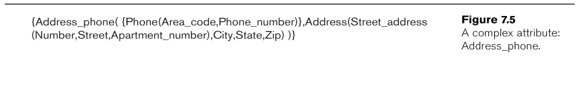
Complex Attribute
We may have arbitrarily nested composite (using (,,) to separate components) and multi-valued attributes (using {} to indicate the sub-attribute inside {} is multi-valued), which is called Complex Attribute
For example: if a person can have more than one residence and each residence can have a single address and multiple phones

Slide 23
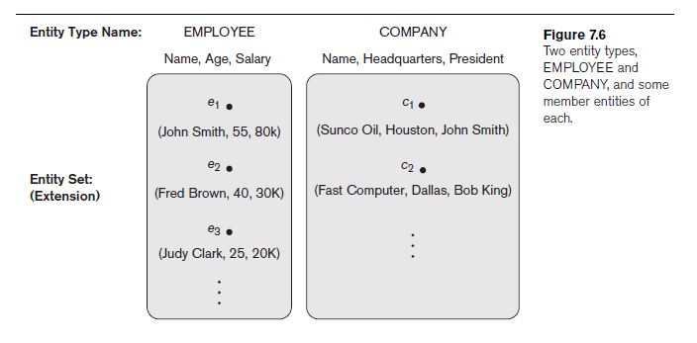
Entity Types
A database usually contains groups of entities that are similar
An entity type defines a collection of entities that have the same attributes
  For example---EMPLOYEE

Slide 24
ER Diagrams
An entity type is represented in ER diagrams as a rectangular box enclosing the entity type name
Attributes names are enclosed in ovals and are attached to their entity type by straight lines
Composite attributes are attached to their component attributes by straight lines
Multivalued attributes are displayed in double ovals

Slide 25
Entity Type CAR with two keys and a corresponding Entity Set

Slide 26
Key Attributes
An important constrain on the entities of an entity type is the KEY on attributes
An attribute of an entity type for which each entity must have a unique value is called a key attribute of the entity type.
  For example, SSN of EMPLOYEE.

Slide 27
Entity Types and Key Attributes (2)
A key attribute may be composite.
  VehicleTagNumber is a key of the CAR entity type with components (Number, State).
An entity type may have more than one key.
  The CAR entity type may have two keys:
    VehicleIdentificationNumber (popularly called VIN)
    VehicleTagNumber (Number, State), aka license plate number.
Each key is underlined

Slide 28
Entity Type CAR with two keys and a corresponding Entity Set

Slide 29
Initial Design of Entity Types for the COMPANY Database Schema
Based on the requirements, we can identify four initial entity types in the COMPANY database:
  DEPARTMENT
  PROJECT
  EMPLOYEE
  DEPENDENT
Their initial design is shown on the following slides
The initial attributes shown are derived from the requirements description

Slide 30
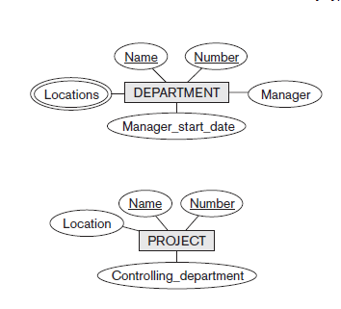
Department
  The company is organized into DEPARTMENTs. Each department has a name, number and an employee who manages the department. We keep track of the start date of the department manager. A department may have several locations.

Slide 31
Projects
  Each department controls a number of PROJECTs. Each project has a unique name, unique number and is located at a single location.

Slide 32
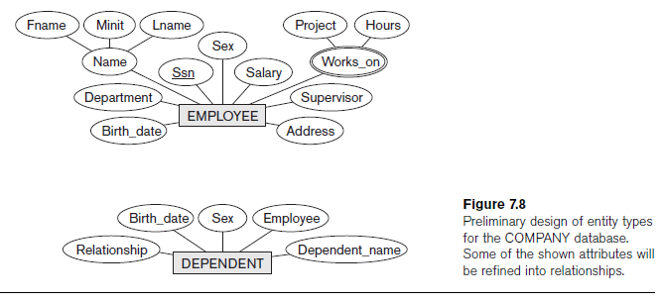
EMPLOYEE
  We store each EMPLOYEE’s name, social security number, address, salary, sex, and birthdate.
    Each employee works for one department but may work on several projects.
    We keep track of the number of hours per week that an employee currently works on each project.
    We also keep track of the direct supervisor of each employee.

Slide 33
Dependent
  Each employee may have a number of DEPENDENTs.
    For each dependent, we keep track of their name, sex, birthdate, and relationship to the employee.

Slide 34
Initial Design of Entity Types:
EMPLOYEE, DEPARTMENT, PROJECT, DEPENDENT

Slide 35
Outline
Overview of the database design
An Example Database Application
Entity Types, Entity Sets, Attributes, and keys
Relationship

Slide 36
Relationship
The initial design is typically not complete
Refining the initial design by introducing relationships
ER model has three main concepts:
  Entities (and their entity types and entity sets)
  Attributes (simple, composite, multivalued)
  Relationships (and their relationship types and relationship sets)

Slide 37
Relationship
Relationship
  When an attribute of one entity type refers to another entity type
  Represent references as relationships not attributes

Slide 38
Initial Design of Entity Types:
EMPLOYEE, DEPARTMENT, PROJECT, DEPENDENT

Slide 39
Relationships based on Initial Design

Slide 40
Relationship type vs. relationship set
Relationship Type:
  Is the schema description of a relationship
  Identifies the relationship name and the participating entity types
  Also identifies certain relationship constraints
Relationship Set:
  The current set of relationship instances represented in the database
  The current state of a relationship type

Slide 41
Relationship
In ER diagrams, we represent the relationship type as follows:
  Diamond-shaped box is used to display a relationship type
  Connected to the participating entity types via straight lines

Slide 42
Relationship example
Consider a relationship type work_for between the two entities type EMPLOYEE and DEPARTMENT
Each relationship instance in the relationship set associates one EMPLOYEE entity and one DEPARTMENT entity

Slide 43
Relationship between EMPLOYEE and DEPARTMENT

Slide 44
Degree of Relationship Type
The degree of a relationship is the number of participating entity types
A relationship type of degree two is called Binary, and one of degree three is called Ternary
Work_for relationship is binary
An example of ternary relationship is SUPPLY---where S supply part P to project J

Slide 45
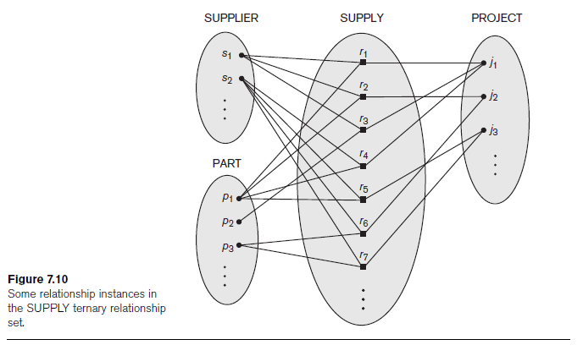
Example of Ternary Relationship

Slide 46
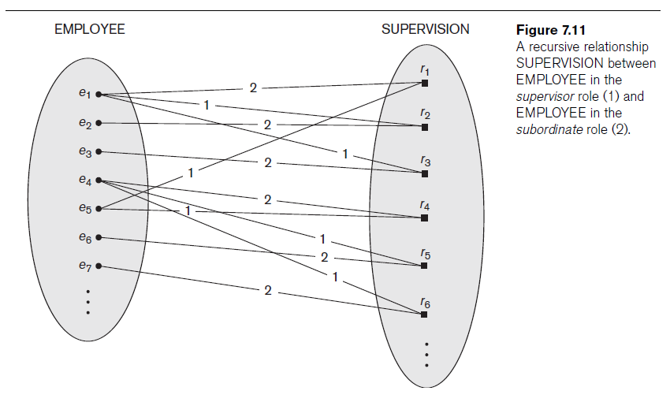
Recursive Relationship
In some cases, the same entity type participates more than once in a relationship type in different roles
Example Employee and supervised

Slide 47
ER DIAGRAM

Slide 48
Constrains on Relationship types
Sometimes if we want to describe “each employee must work for exactly one department”, then we would like to describe this constrain in the schema
The cardinality ratio for a binary relationship specifies the max number of relationship instances that an entity can participate in.
For example---in the Works_for binary relationship, DEPARTMENT:EMPLOYEE is of cardinality ratio 1:N, meaning each department can be related to any number of employees, but an employee can only be related to one department

Slide 49
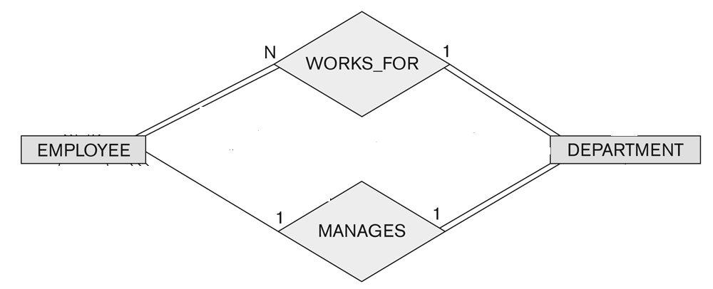
Relationship between EMPLOYEE and DEPARTMENT

Slide 50
Cardinality Ratio
The possible cardinality ratio for binary relationships are 1:1, 1:N, N:1, M:N
Example:
  1:1 Manages relationship between employee and department
  M:N an employee can work on several projects and a project can have several employees

Slide 51
Participation Constrain
The participation constrain specifies whether the existence of an entity depends on its being related to another entity via the relationship type
There are two types of participation constrains:
  Total
  Partial

Slide 52
Participation Constrain
For example
If a company policy states that every employee must work for a department, then it’s total
Not every Employee is a Manager, so this relationship is partial

Slide 53
Relationship between EMPLOYEE and DEPARTMENT

Slide 54
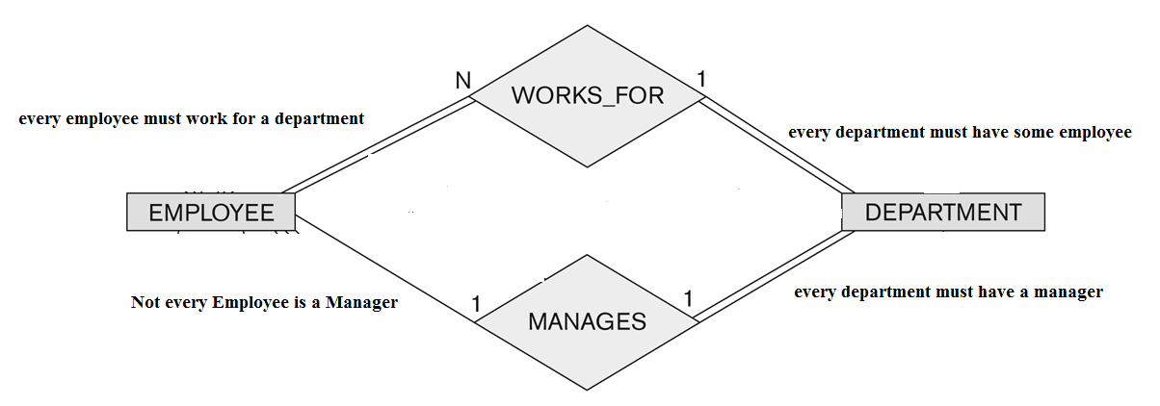
Relationship between EMPLOYEE and DEPARTMENT

Slide 55
ER DIAGRAM

Slide 56
Alternative Notations for ER Diagrams
Specify structural constraints on relationships
  Replaces cardinality ratio (1:1, 1:N, M:N) and single/double line notation for participation constraints
  Associate a pair of integer numbers (min, max) with each participation of an entity type E in a relationship type R, where 0 ≤ min ≤ max and max ≥ 1

Slide 57
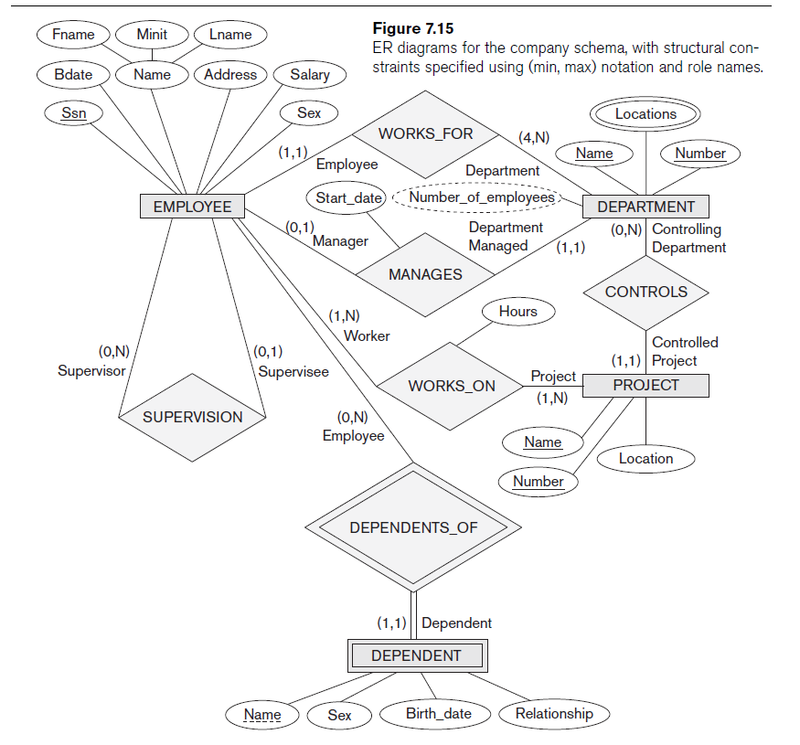

Slide 58
Weak Entity Types
Entity types do not have key attribute of their own are called weak entity types
In contrast, regular entity types that do have key attribute are called strong entity types

Slide 59
Weak entity type Example
Consider the entity type DEPENDENT, related to EMPLOYEE
They are identified as distinct entities only after determining the particular employee entity (owner entity) to which dependent is related
A weak entity type normally has a partial key, which is the set of attributes that can uniquely identify weak entities that are related to the same owner entity

Slide 60
Weak entity type representation in ER diagram
In ER diagrams, both weak entity type and its identifying relationship (relate a weak entity type to its owner) are distinguished by surrounding their boxes and diamonds with double lines
The partial key attribute is underlined with a dashed line

Slide 61
ER DIAGRAM

Slide 62
Weak Entity Type
Weak entity types can sometimes be represented as complex attributes
Complex Attributes: combination of composite and multi-valued attributes
In the example, we could specify a multi-valued attribute Dependents for EMPLOYEE, which is a composite attribute with component attributes Name, Birthday, Sex and Relationship
The choice of which representation to use is made by the database designer

Slide 63
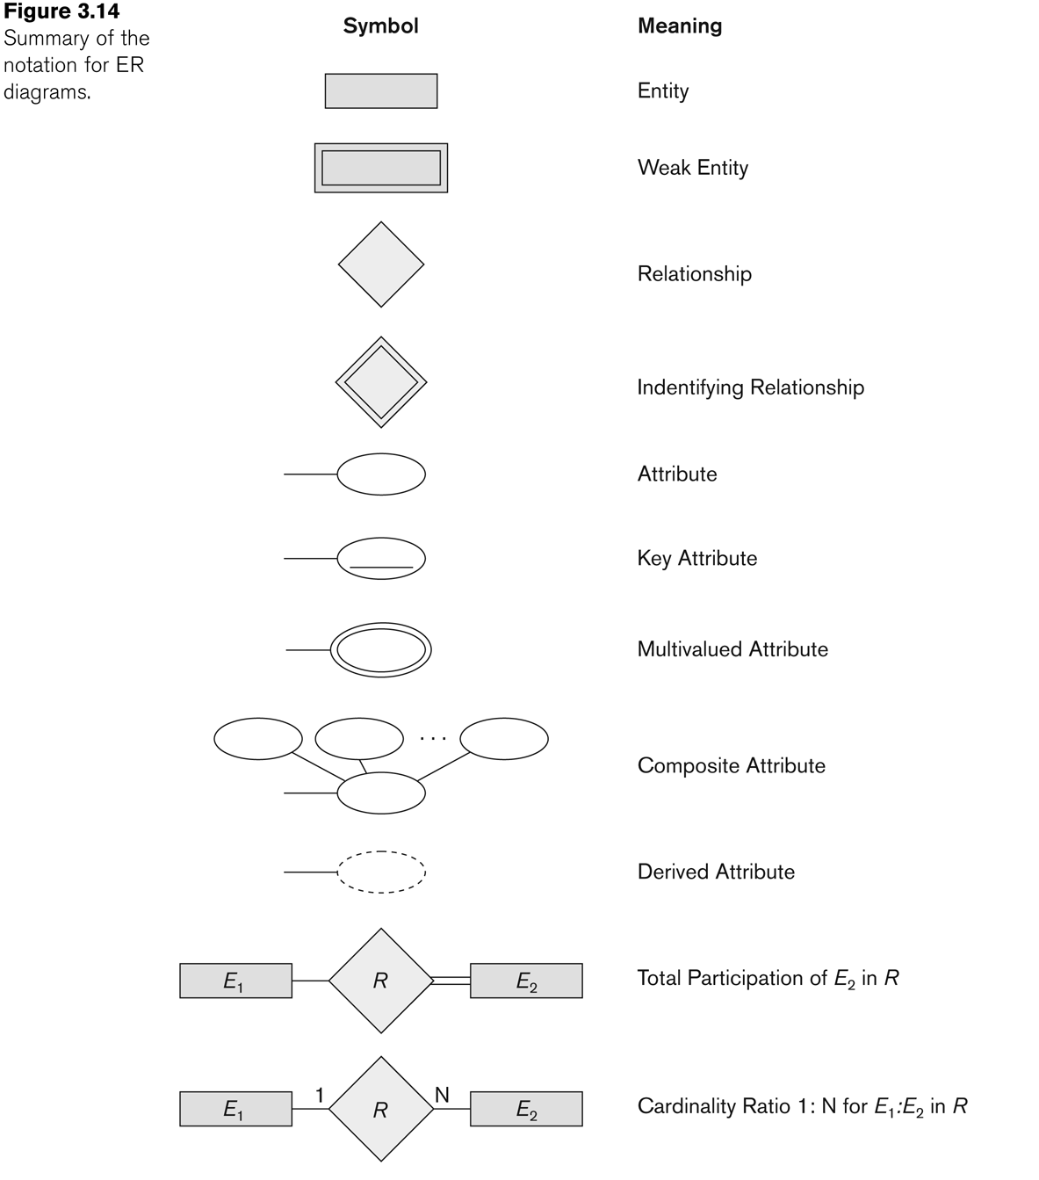
Summary of notation for ER diagrams

Slide 64
Relationships of Higher Degree
Relationship types of degree 2 are called binary
Relationship types of degree 3 are called ternary and of degree n are called n-ary
In general, an n-ary relationship is not equivalent to n binary relationships

Slide 65
Choosing between Binary and Ternary relationships
SUPPLY relationship, is a set of relationship instances (s, j, p), where s is a SUPPLIER who is currently supplying a PART p to a PROJECT j
In general, a relationship type R of degree n will have n edges in an ER diagram, one connecting R to each participating entity type

Slide 66
Choosing between Binary and Ternary relationships
The figure below shows an ER diagram for three binary relationship types CAN_SUPPLY, USES, SUPPLIES
In general, 3 binary relationships can represent different information than a single ternary relationship
If needed, the binary and n-ary relationships can all be included in the schema design

Slide 67
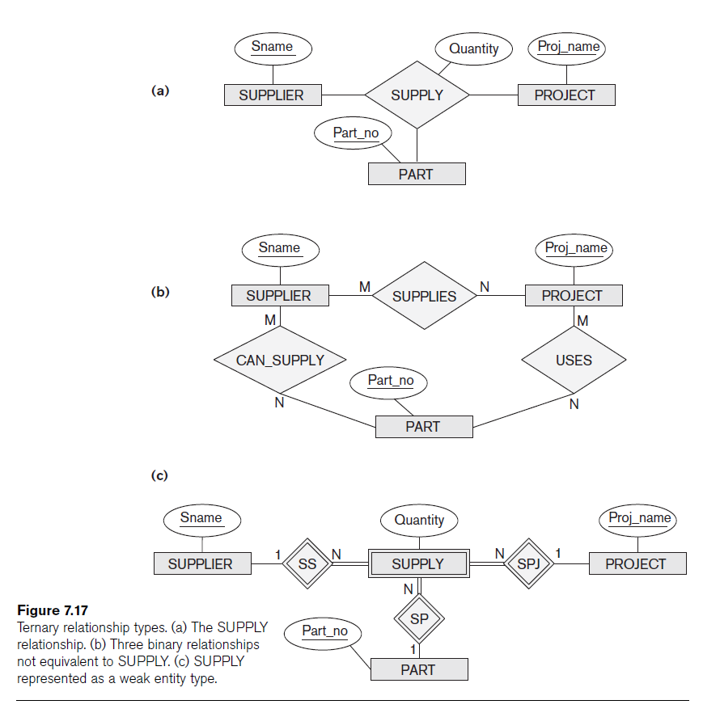

Slide 68
Choosing between Binary and Ternary relationships
Some database design tools permit only binary relationships
  Ternary relationship must be represented as a weak entity type
  With no partial key and with three identifying relationships
Represent ternary relationship as a regular entity type
  By introducing an artificial or surrogate key

